Slide 1
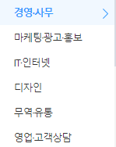
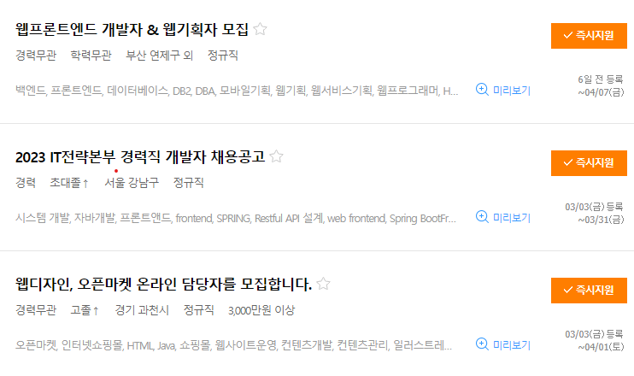
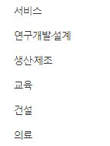

Job List
Recruit

Slide 2
CAREER
-
Career 1
Detail
-
Career 2
Detail
PORTFOLIO
+
Detail
2023.03
NAME
W JOB
-
Job 1
Detail
-
Job 2
Detail
+
Detail
1/10 page
Download

Slide 3
PORTFOLIO
Project Detail
Project Progress
Leader Portfolio
Manager Portfolio
Detail
N JOB
-
Job 1
3 명
-
Job 2
2 명
+
0 명

